Slide 1


Web HackerSpace

Slide 2
What does this class teach you? Why is it useful?
Full Stack Development
Hackathons, Work, 196 Projects, Random Ideas
How is the class structured?
In class projects, no homework

Slide 3
Agenda
Week 1: HTTP Basics, Setting up environment, HTML
Week 2: HTML & CSS Basics & Intro to Design
Week 3: Movie in-class Project , Design Contest
Week 4:, Movie in-class Project, Web Application Structure
Week 5: Intro to Flask
Week 6: Flask Twitter Project Part 1
Week 7: Flask Twitter Project Part 2
Week 8: Intro to React
Week 9: React project part 1 (TBD)
Week 10: React project part 2 (TBD)

Slide 4




World Wide Web (How it works
YOUR COMPUTER/ BROWSER
SERVERS
HTTP REQUESTS
HTTP RESPONSES
YOU
THE INTERNET
Browser: A program that runs on your computer to display the files on the web
Internet: The world’s largest computer network
Servers: Computers that host the files that make up the web
HTTP: The main protocol of the web

Slide 5
Requests
GET: fetch an existing resource
POST: create a new resource
PUT: update an existing resource
DELETE: delete an existing resource

Slide 6
Get Requests vs Post Requests
The Parameters are in URL
Restricted by max URL length
Used mainly for fetching documents
Ok to cache
Should not change server
Parameters are in the body
No max length (unless server has restrictions)
Used mainly for updating data
Not ok to cache
Can be used to change the server

Slide 7
Status Codes
1xx: Informational Messages
2xx: Successful
202: Accepted
3xx: Redirection
301: Moved Permanently
4xx: Client Error
400: Bad Request
401: Unauthorized
403: Forbidden
404: File Not Found
5xx: Server Error
Notes:
Error 401 - Unauthorized: Access is denied due to invalid credentials. This behavior occurs if the following conditions are true (usually uses authentication)
The 403 Forbidden error is an HTTP status code which means that accessing the page or resource you were trying to reach is absolutely forbidden for some reason.

Slide 8
Text Editors
VS Code
Sublime
Atom

Slide 9



Atom
Visual Studio Code
Sublime Text Editor
Smooth UI
Packages
Linters
Git
Customization
Slow though
Computer Testing Center at UIUC has Atom installed
Fast
Git integration,
Integrated Terminal
Plugins for customizable features
Simple UI
Fast
Syntax completion/ shortcuts
Customization
No git plugin
https://code.visualstudio.com/Download
https://www.sublimetext.com/3
https://atom.io/

Slide 10
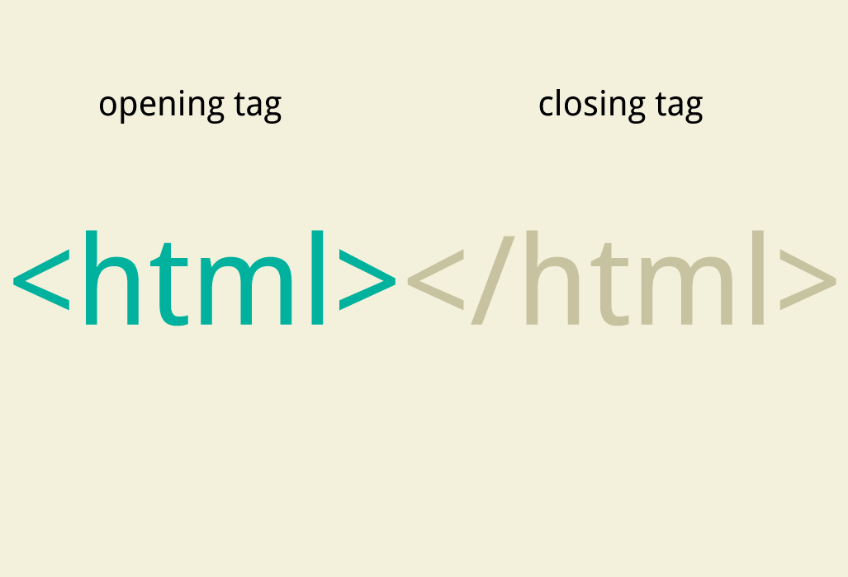
HTML
Hyper Text Markup Language
Notes:
http governs how those files are exchanges - does not specify format. HTML specifies the format for the most important files-html

Slide 11
Hello World
Notes:
<!DOCTYPE html>
<html>
<head>
<title>Megha’s Hello World</title>
</head>
<body>
<p>Hello World!</p>
</body>
</html>

Slide 12
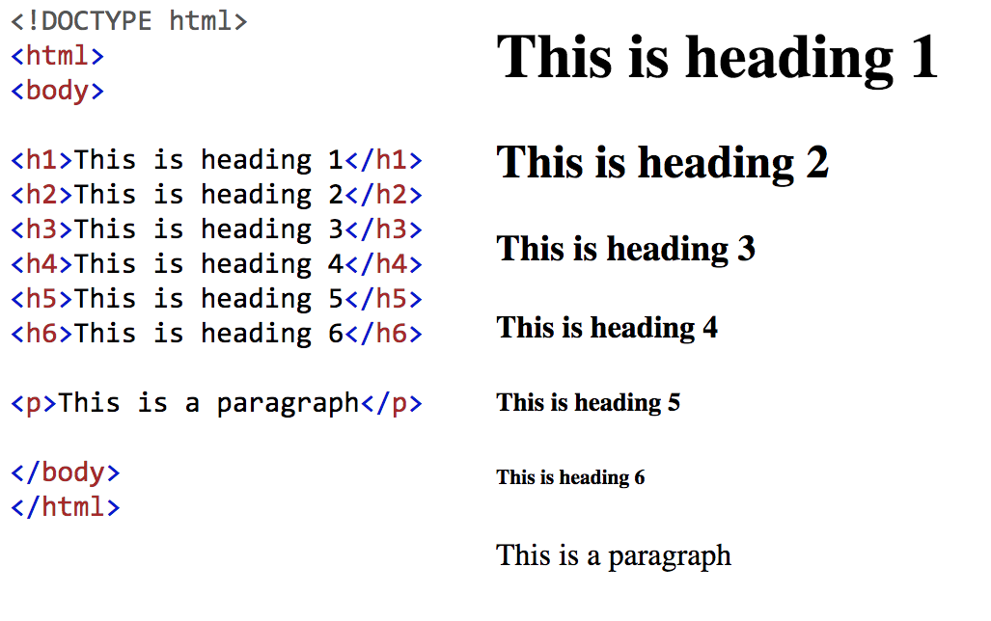
Comparing headings and paragraph

Slide 13
Tags
Inline Tags
Block Tags
File level Tags

Slide 14
Inline Tags
Block Tags
File Level Tags
Do not usually create a new line
Takes only the width of what it’s surrounding
Also called “Text Level Tag”
Ex: (Try one of these on your “hello world” text and see what it does)
<i></i>
<b></b>
Always starts a new line
Takes up the full width available
Ex: (Add another block tag after the tag surrounding “hello world”)
<p></p>
<h1></h1>
Provides structure for your webpage
Ex:
<html></html>
<head></head>
<body></body>
IMPORTANT
Tags must be fully nested inside each other
<i><b> hi</i>kok</b> does not work bc it is not fully contained
Notes:
tags need to be fully nested inside each other
<i><b> hi</i>kok</b> - does not work bc it is not fully contained

Slide 15
Links
A local file
<a href =“saltBae.html”>Salty</a> a file
A url
<a href= “www.saltBae.com”>Salty</a>

Slide 16
Images
<img src = “sipsTea.jpg” alt= “Sips Tea Image”/>
If you want a url just put the link in the “src section”

Slide 17
See You Next Week!
Notes:
<!DOCTYPE html>
<html>
<head>
<title>Megha’s Hello World</title>
</head>
<body>
<p>Hello World!</p>
</body>
</html>

